Slide 1


Slide 2


TODAY’S AGENDA
Introduction To AJAX
Advantages Of AJAX
Introduction To XMLHttpRequest class
Steps In AJAX Programming
Examples

Slide 3
PREREQUISITES
Familiarity with the following:
CLIENT SIDE
HTML
CSS
Java Script
DOM
SERVER SIDE
JSP
Servlets
JDBC

Slide 4
INTRODUCTION
AJAX stands for Asynchronous Java script And Xml
AJAX is not a new language , rather it is a new style of programming made popular by Google in 2007 and today it is the backbone of every dynamic web application.

Slide 5
NEED OF AJAX
When java script was released , it was able to interact with html but it had no way of communicating with the server.
Thus , the only way html page could communicate with a server side script like php or jsp was to make html form containing a submit button and generating get or post request .

Slide 6
NEED OF AJAX
Now , when the user clicks submit button a new page is generated by the server containing the desired results
But , sometimes on slow networks this could take time .
Moreover most of the time the new page has 90% elements same as the previous page only 10% of data gets changed.

Slide 7
SOLUTION
Ajax attempts to remedy this problem by letting our Java script communicate directly with the server, using a special Java script object XMLHttpRequest.
With this object, our Java script can get information from the server without having to load a new page!

Slide 8
STEPS OF AJAX PROGRAMMING
Following are the steps involved in AJAX :
Create Object for Ajax Request.
Specify a Handler.
Send the request.
Retrieve the data.

Slide 9
CREATING -OBJECT
The first step in AJAX based communication is to create an object of type XMLHttpRequest.
It is a built in class supported by every browser which has some very important properties/methods for generating Ajax request and receiving response.

Slide 10
CODE
<script >
var ajaxreq=new XMLHttpRequest();
.
.
.
.
</script>

Slide 11
SPECIFY HANDLER
When we use AJAX we can’t be sure when the response will come back .
So before we generate the request we must first specify a function to be called when the response comes back from the server.
This function is called “RESPONSE HANDLER”.

Slide 12
SPECIFY HANDLER
Tasks of RESPONSE HANDLER :
Receive the information sent by server.
Extract the data.
Display the result at appropriate place.

Slide 13
SPECIFY HANDLER
Syntax :
ajaxreq.onreadystatechange=<func name>;
The onreadystatechange is the property of the AJAX object which receives a function name as it’s value and every time the readyState property of the AJAX object changes then the function gets executed

Slide 14
THE readyState PROPERTY
The process of communicating with the server begins with sending of the request and finishes when the response comes back .
In between there are many stages involved and these stages are represented using the readyState property

Slide 15
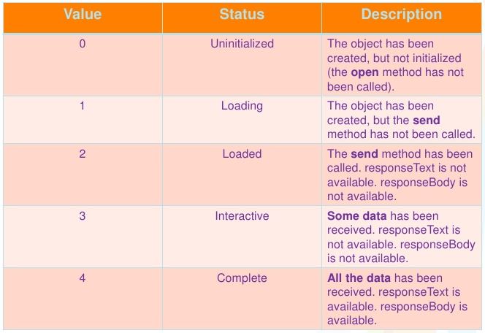
readyState VALUES

Slide 16
THE readyState PROPERTY
Every time the readyState changes the function indicated by the onreadystatechange property gets called.
There are five steps , so function will be called four times
But we are interested in the completed state because the data is only available after the state is 4

Slide 17
THE Handler FUNCTION
function< function name>()
{
if (ajaxreq.readyState==4)
{
// do something with the data
}
}

Slide 18
SEND THE INFORMATION
After we have specified handler we can send request to the server.
This involves 2 steps:
Opening the connection .
Sending the request.

Slide 19
OPENING THE CONNECTION
Before sending the request we need to establish a connection to the server which is done by calling the method open( ) of the XMLHttpRequest object.
It has the following prototype:
open(method , url , isasynchronous)

Slide 20
OPENING THE CONNECTION
method : The type of method being requested GET or POST
url : URL of the page to request.
isasynchronous: a boolean value indicating whether request will be asynchronous (true) or synchronous(false).

Slide 21
OPENING THE CONNECTION
Sample Call 1:
ajaxreq.open(“GET” ,”getdetails.jsp”,true);
Sample Call 2:
ajaxreq.open(“GET” ,”getdetails.jsp?roll=15”,true);

Slide 22
SENDING THE REQUEST
Once we have established the connection to the server we can send request to the server.
To do this we use another method provided by the XMLHttpRequest object called send() which has the following form:
send(parameter);
If we have used “GET” as argument in open() then we pass null as parameter.

Slide 23
SENDING THE REQUEST
Otherwise if we have used “POST” as argument in open() then we have to do 2 things:
Call the setRequestHeader() method passing it “content-type”, “ application/x-www-form-urlencoded” as argument. This tells the server that the data is being sent as a part of request body.
Call send () by passing required parameter as argument.

Slide 24
SAMPLE
So the complete steps will become :
ajaxreq.open(“POST” , “getdetails.jsp” , true);
ajaxreq.setRequestHeader(“content-type” , “application/x-www- form-urlencoded”);
ajaxreq.send(“roll=10”):

Slide 25
RETRIEVE THE DATA
The last step is to receive the response sent by the server .
This done by accessing the property responseText of XMLHttpRequest object

Slide 26
SYNTAX
function <function name> ()
{
If(ajaxreq.readystate==4)
{
var x= ajaxreq.responseText;
//further processing
}
}

Slide 27
EXERCISE 1
Write an AJAX based application to get the date from server and display it on the page.

Slide 28
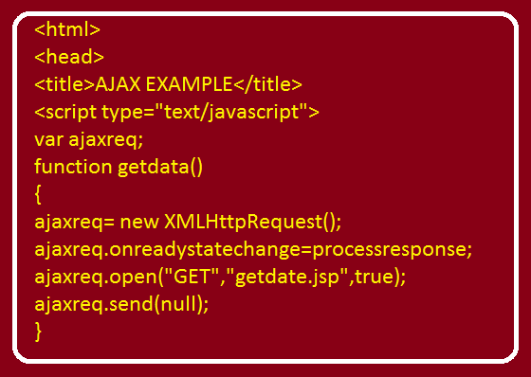
SOLUTION (The html Page)

Slide 29
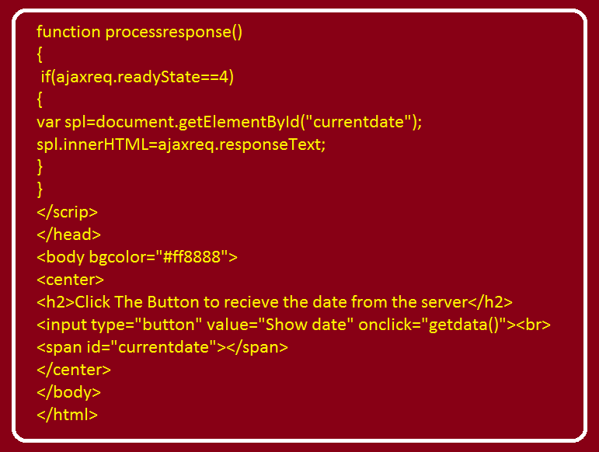
SOLUTION (The html Page)

Slide 30
SOLUTION (The jsp Page)
<%@ page import="java.util.*,java.text.*" %>
<%
Date today=new Date();
SimpleDateFormat sdf=new SimpleDateFormat("dd-MMM-yyyy");
String str=sdf.format(today);
%>
<h3>Date at server is <%= str %></h3>

Slide 31
EXERCISE 2
Write an AJAX based application to accept two nos from the user , send them to the server, receive their sum from the server and display the result on the page.

Slide 32
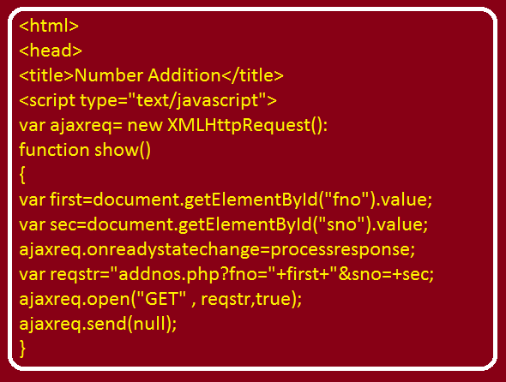
SOLUTION (The html Page)

Slide 33
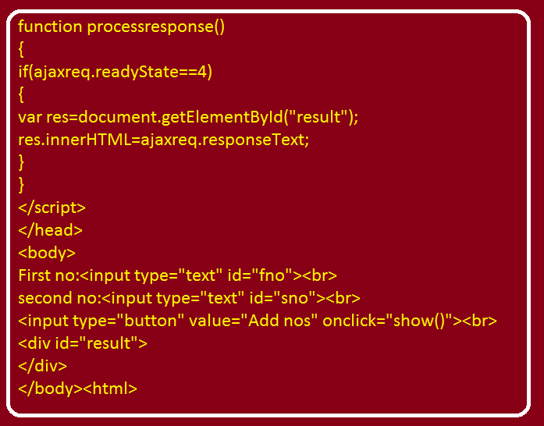
SOLUTION (The html Page)

Slide 34
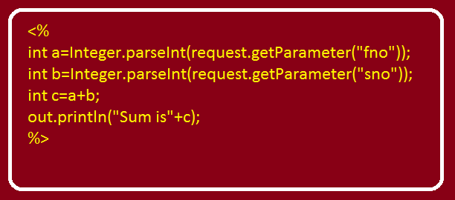
SOLUTION (The jsp Page)

Slide 35
EXERCISE 3
Write an AJAX based application to accept an Employee Name from the user , send it to the server, receive his/her salary from the server and display the result on the page.
Assume names of all the Employees and their salaries are stored in the database in a table called EMP with columns as ENAME and SAL.

Slide 36
EXERCISE 4
Write an AJAX based application to accept an UserName from the user , and verify whether this username is available or not. If it is available then show the message “username available” in green and if it is not available then show the message “username not available” in red.
Assume names of all the users and their passwords are stored in the database in a table called ALLUSERS with columns as USERNAME and PASSWORD

Slide 37
EXERCISE 5
Write an AJAX based application to accept an Employee Name from the user , send it to the server, receive details (EMPNO,ENAME,SAL,JOB)from the server and display the result on the page.
Assume names of all the Employees and their salaries are stored in the database in a table called EMP with columns as EMPNO,ENAME,SAL and JOB.

Slide 38
EXERCISE 6
Write an AJAX based application to allow the user to select an Employee Number from a drop down list , send it to the server, receive his/her ENAME,DEPTNO,SALARY and JOB from the server and display the result on the page. Make sure the Employee Numbers shown are also picked from the database.
Assume names of all the Employees and their salaries are stored in the database in a table called EMP with columns as ENAME and SAL.

Slide 39
EXERCISE 7
Modify the EXERCISE 5 , so that even if the user presses ENTER key after inputting ENAME then also record should be displayed.

Slide 40
EXERCISE 8
Develop an AJAX based REGISTRATION APPLICATION having following behaviour:
The registration page should have following fields:
(i) User ID (It should be your email id).
(ii) Password
(iii) UserName
If registration is successful then it should
welcome the user (Make sure registration only happens if the User ID provided is available).
If User ID is not available it should ask user to register
again with different user ID.

Slide 41
EXERCISE 9
Develop AJAX base login application. Your app should do the following
1. Perform validation
2. If validation is successful then login credentials should be passed to server
3. At the server end login credentials should be verified with the database and accordingly the response should be generated
Finally this response should be generated on the page via AJAX.

Slide 42
PROBLEMS WITH OUR APPROACH
Although our previous examples worked correctly and did the task but there is a serious flaw in our approach.
We have clubbed all the tasks related to our application in one single place i.e servlet/jsp which is not at all recommended by the industry.

Slide 43
PROBLEMS WITH OUR APPROACH
At the industry level , we divide our project into different layers and each layer plays a different role.
In most web applications we have 3 layers called:
Presentation Layer: Deals with the UI
Business Layer: Deals with the main application logic
Persistence Layer: Handles DB interaction
At every layer we design different components to fulfill the task.

Slide 44
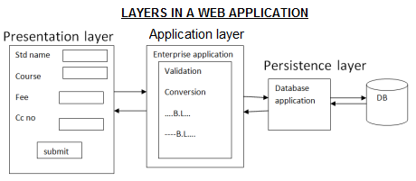
THE LAYERED APPROACH

Slide 45
THE MVC MODEL
MVC Design Pattern is one of the oldest architectural pattern for web applications.
MVC stands for Model View Controller and is used to separate the project logic into different layers

Slide 46
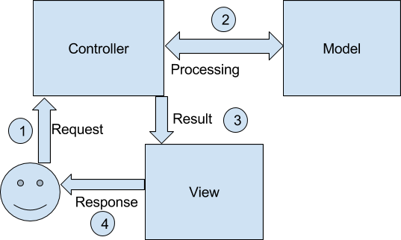
THE MVC MODEL
With MVC design pattern, we have following components on which our design depends:
The Model which is transferred from one layer to the other.
The View which is responsible to show the data present in the application.
The Controller is responsible to accept a request from a user, modify a model and send it to the view which is shown to the user.

Slide 47
THE MVC MODEL
A very good feature of the MVC design pattern is that is hides the data access layer from the users.
That is, the data access layer or the data is never actually called directly by the user; from the interface.
This way, the user can only perform the actions that he is allowed to.
This feature allows the developers to create groups or roles of users that are allowed to access the data; such as Admins, Guests etc.

Slide 48
MVC IN JAVA
The Controller Servlet handles the user’s request. (This means the hyperlink in the HTML/JSP should point to the controller servlet).
The Controller Servlet then instantiates appropriate POJO based on the request parameters
The Controller Servlet then communicates with the Model Tier to fetch the required data.
The Controller sets the response to be forwarded to View JSP/HTML
The controller then dispatches the request to the next view based on the request URL.
The View uses the resultant response to display data.

Slide 49
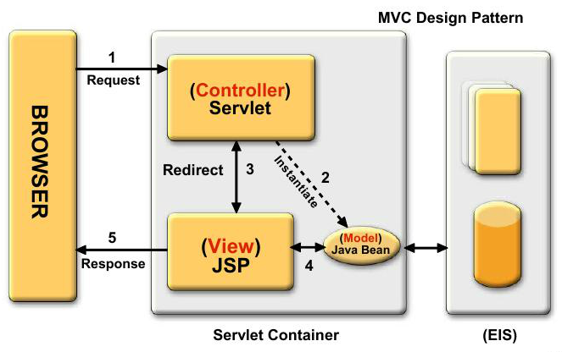
MVC IN JAVA

Slide 50
THE DAO PATTERN
DAO stands for Data Access Object.
DAO Design Pattern is used to separate the data persistence logic in a separate layer.
This way, the servlet remains completely in dark about how the low-level operations to access the database is done.

Slide 51
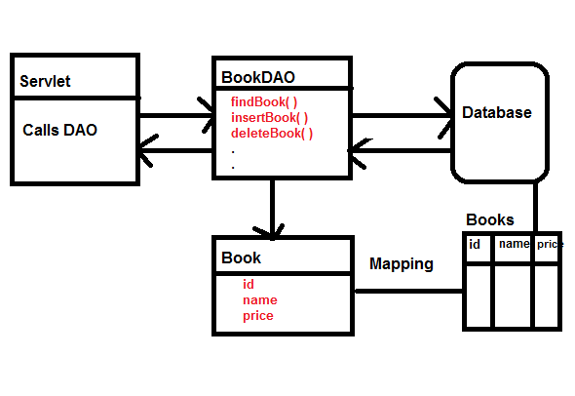
DAO PATTERN IN JAVA

Slide 52
PROJECT STRUCTURE
Based on previous discussions , our web-app will have the following structure:
HTML/JSP/JS: All the front end code is written here. It contains all the UI elements our application will have. The execution will begin from here. All the calls will be made from here.
Servlet(Controller) : This will be entry point of our application at the server end . It will receive the request from the HTML and further transfer it to the DATA ACCESS LAYER
DAO(Data Access Object) : All the classes that interact with the database. It contains all the methods like search( ), add( ), delete ( ) etc
DBConnection : The database connection class. It will contain method to load the driver class, open the connection to the db and close the connection to the database.
DTO or POJO (Plain Old Java Objects) : These classes will hold the data of our
application i.e. they hold the data coming from the table or to be stored into the table

